Slide 1
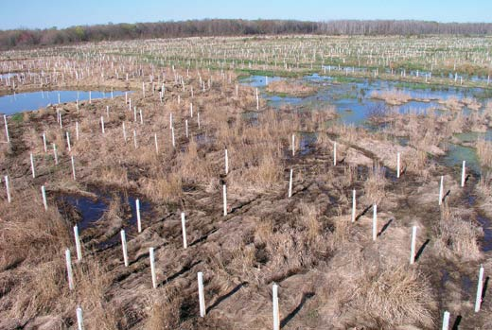
Statewide Multi-agency Mitigation Banking Templates
Tom Cavanaugh
Administrative Appeal Review Officer
South Pacific Division
March 1, 2017

Slide 2
Overview
Background
Purpose of the Templates
Purpose of Meeting
Equivalent Standards
Overview and discussion of Changes
Key Issues
Future Updates and Other Templates

Slide 3
Background
Late 2003
Work begins on templates for California portion of Sacramento District (SPK)
December 2004
Joint San Francisco District (SPN) / SPK mitigation guidelines
May 2005
Statewide mitigation banking template effort begins
Early 2006
7 Agency MOU

Slide 4
Background
April 10, 2008
Compensatory Mitigation for Losses of Aquatic Resources; Final Rule
Published jointly by the U.S. Army Corps of Engineers (USACE) and the Environmental Protection Agency (EPA)
May 2008
Public notice of final Bank Enabling Instrument (BEI), Conservation Easement (CE), Management Plan, Property Assessment and Warranty, and mitigation banking checklists
October 2011
2011 8-Party Memorandum of Understanding (MOU)
January 2015
Final 2015 Regional Compensatory Mitigation And Monitoring Guidelines, South Pacific Division (SPD)

Slide 5
Background
2011 8-Party Memorandum of Understanding (MOU)
2011 MOU improves on 2006 MOU by adding:
Sacramento (SPK), Los Angeles (SPL), and San Francisco (SPN) District Commanders as signatories
The State Water Resources Control Board (State Water Board) as a signatory
Collaboration on development of In-lieu fee (ILF) programs and templates
A dispute resolution role for the Bank Agency Management Team (BAMT) relative to Project Delivery Team (PDT) disagreements or impasses
A responsibility for Interagency Review Teams (IRT) to seek BAMT approval for significant deviations from templates or guidance in the development of individual banks or ILF programs
A commitment from all agencies to work toward meeting the timelines from the 2008 mitigation rule
An agreement for IRT agencies to coordinate prior to providing potentially conflicting direction to bankers or ILF program sponsors

Slide 6
Background
September 2015
Public notice of the availability of the draft updated BEI an CE templates and request for comments
http://www.spd.usace.army.mil/Missions/Regulatory/Public-Notices-and-References/Article/620773/updated-bei-and-ce-templates/
September 2016
Public Meeting concerning the proposed BEI and CE templates
Held in response to comments received, following the Public Notice, requesting an opportunity to verbally present additional comments on proposed updates to the BEI and CE templates
http://www.spd.usace.army.mil/Missions/Regulatory/Public-Notices-and-References/Article/926729/announcement-of-public-meeting-updated-mitigation-bank-templates-for-enabling-i/

Slide 7
Purpose of the Templates
Insuring all applicable legal and regulatory requirements are met
Consolidates requirements from multiple agencies
Includes requirements from mitigation rule
Aiding prospective bankers in developing banking documents
Implementing equivalent, effective standards
Ensuring predictability and efficiency
Expediting mitigation bank review

Slide 8
PURPOSE OF THIS meeting
Overview of efforts to assure all mitigation is held to equivalent, high standards
Discuss changes made to BEI and CE templates made in response to comments and concerns
http://www.spd.usace.army.mil/Missions/Regulatory/Public-Notices-and-References/Article/1061258/announcement-of-public-meeting-and-workshop/
Discuss any remaining concerns with proposed final BEI and CE templates
Discussion of future templates and updates
Process
Involvement

Slide 9
Equivalent STandards

Slide 10
Equivalent Standards
Equivalent standards
Mitigation Banks
Permittee Responsible Mitigation(PRM)
in-lieu fee (ILF) Programs
Not identical standards
There will always will be differences.
There will always be opportunities to improve.

Slide 11
Equivalent Standards
The Corps South Pacific Division (SPD) and the 4 SPD Districts (Sacramento, San Francisco, Los Angeles, and Albuquerque) have developed:
Regional Compensatory Mitigation and Monitoring Guidelines:
Same standards for all mitigation projects
Requires all applicable documentation for ILF and PRM that has been required for mitigation banks
http://www.spd.usace.army.mil/Portals/13/docs/regulatory/mitigation/MitMon.pdf
Standard Operating Procedure for Determination of Mitigation Ratios
Ensures that the factors are considered in determining the amount of mitigation a particular project would require
Results typically favor banks in the same watershed, with the appropriate type of mitigation
http://www.spd.usace.army.mil/Portals/13/docs/regulatory/qmsref/ratio/12501.pdf
Uniform Performance Standards for Compensatory Mitigation
Performance, to the degree appropriate, is being measured in the same way for all mitigation
http://www.spd.usace.army.mil/Portals/13/docs/regulatory/qmsref/ups/12505.pdf

Slide 12
Equivalent Standards
Coming soon
Vernal pool mitigation guidelines
http://www.spd.usace.army.mil/Missions/Regulatory/Public-Notices-and-References/Article/996958/2016-dvpgl-draft-vernal-pool-mitigation-and-monitoring-guidelines/
Future Actions
Separate from this effort, follow-up with the Districts concerning implementation of these standards will be essential to ensure that all forms of mitigation are being treated equally.
Possibility of a retrospective look at mitigation, including PRM.
What’s worked?
What hasn’t worked?
What needs to be done better?

Slide 13
Key Changes: BEI
California Department of Fish and Wildlife (CDFW):
Name change to CDFW
New FGC § 1798 banking statute information added to the BEI
Added new laws under Authorities
Endowment language updated due to FGC §65965-65969 statute changes
Conservation Easement (CE) statute and information updated

Slide 14
Key Changes: BEI
Addition of IRT agencies and associated credits:
State Water Quality Control Board (State Water Board)
Regional Water Quality Control Boards (Regional Water Boards)
National Marine Fisheries Service (NMFS)

Slide 15
Key Changes: BEI
Definitions Deleted:
Catastrophic Event
Special Deposit Fund (FGC§ 13014)
Unlawful Act
Definitions Added:
Construction Phase
Endowment Agreement
Endowment Amount
Endowment Holder
Habitat Establishment
RIBITS
Subsequent Phase
Definitions Modified:
Endowment Fund
Extraordinary Circumstances
(formerly “Force Majeure”)
Implementation Fee
Remedial Action
Waters of the State

Slide 16
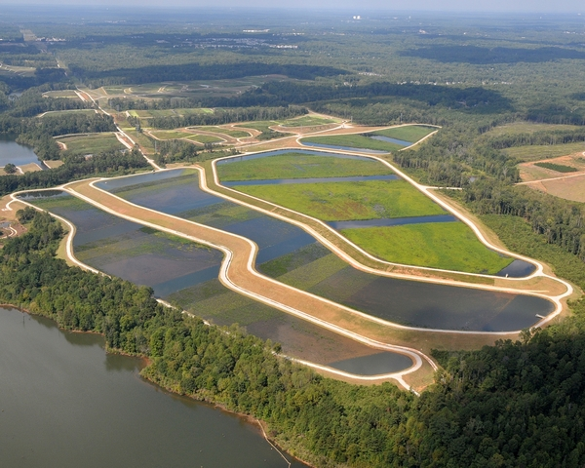
Key Changes: BEI
Construction phase or Subsequent phase?
Subsequent Phase is not covered or described in an approved BEI.
Includes phases mentioned in BEI, but which lack sufficient detail for review and approval.
Construction Phase is detailed in an approved BEI.
Includes sufficient information for review and approval.
May be constructed immediately upon bank establishment or at a later date.
Concept of construction phase added to clarify the difference.

Slide 17
Key Changes: BEI
Not a Contract:
No Federal Contract or Monetary Damages
USACE approval of this BEI constitutes the regulatory approval required for the Mitigation Bank to be used to provide compensatory mitigation for Department of Army permits pursuant to 33 C.F.R. §332.8(a)(1). This BEI is not a contract between the Bank Sponsor or Property Owner and USACE or any other agency of the federal government. Any dispute arising under this BEI will not give rise to any claim by the Bank Sponsor or Property Owner for monetary damages. This provision is controlling notwithstanding any other provision or statement in the BEI to the contrary.
Mandated by USACE Headquarters.
USACE Districts are prohibited from signing bank instruments that don’t include this language.
USACE Districts are prohibited from deviating from USACE Headquarters language without express permission.

Slide 18
Key Changes: BEI
Default:
Language is substantially similar to 2008 template language.
Biggest difference is that other sections referencing default are now proposed to refer to default section, rather than try to specify remedy in each related section.

Slide 19
Key Changes: BEI
Default:
The Bank Sponsor and/or Property Owner shall be in default if that party fails to observe or perform any obligations or responsibilities required of it by this BEI. In the event of default, the IRT shall issue a notice of default to Bank Sponsor and/or Property Owner, which includes direction and specified time period to cure the default. If the Bank Sponsor and/or Property Owner fails to remedy the default within the allotted time, the IRT will take appropriate action, which includes but is not limited to, suspending Credit Transfers, reducing available Credits, utilizing financial assurances, and terminating the BEI. This Section shall not be construed to modify or limit any specific right, remedy, or procedure in any Section of this BEI or any remedy available under applicable State and/or Federal Law.

Slide 20
Key Changes: BEI
Credit Release is dependent on:
Funding Endowment
Meeting Performance Standards
Submittal of monitoring reports
Years of monitoring

Slide 21
Key Changes: BEI
Credit Release and Endowment funding: 2008, 2015 & 2016
Establishment - Enhancement or Creation (Not preservation)
Credit Release # | Performance Standard | Credits Released Wetland/Species (Cumulative %) | Endowment to be Funded (Cumulative %) | Performance Standard (error in credit release 3-final) | Credits Released Wetland/Species (Cumulative %) | Endowment to be Funded (Cumulative %) | Performance Standard (these standards were changed back to the 2008 BEI language) | Credits Released Wetland/Species (Cumulative %) | Endowment to be Funded (Cumulative %)
 | 2008 |  |  | 2015 - Public notice |  |  | 2016 - Proposed final
1 | Bank Establishment | 15/15 | 0 | Bank Establishment | 15 | 0 | Bank Establishment | 15 | 0
2 | Submission and approval of as-builts | 40/40 | 15 | Submission and approval of as-builts | 30 | 30 | Submission and approval of as-builts | 30 | 30
3 | Meet year 2 performance criteria | 55/55 | 40 | Meet year 3 performance criteria | 55 | 55 | Meet year 2 performance criteria | 55 | 55
4 | Meet year 3 performance criteria | 70/70 | 70 | Meet year 4 performance criteria | 70 | 70 | Meet year 3 performance criteria | 70 | 70
5 | Meet year 4 performance criteria | 85/100 | 100 | Meet year 5 performance criteria | 85 | 100 | Meet year 4 performance criteria | 85 | 100
Final | Meet year 5 performance criteria | 100/** | ** | Meet final performance criteria | 100 | ** | Meet year 5 performance criteria | 100 | **
The 2015 draft BEI has a provision that the endowment be fully funded prior to 5 years after bank establishment
The 2015 draft was changed in 2016 stating that the endowment shall be fully funded by the 10th anniversary of the first credit release.

Slide 22
Key Changes: BEI
Credit Release and Endowment funding: 2008 vs. 2016
Performance Standard | Credits Released Wetland/Species (Cumulative %) | Endowment to be Funded (Cumulative %)
2008
Bank Establishment | 15/15 | 0
Submission and approval of as-builts | 40/40 | 15
Meet year 2 performance criteria | 55/55 | 40
Meet year 3 performance criteria | 70/70 | 70
Meet year 4 performance criteria | 85/100 | 100
Meet year 5 performance criteria | 100/** | **
Performance Standard (these standards were changed back to the 2008 BEI language) | Credits Released Wetland/Species (Cumulative %) | Endowment to be Funded (Cumulative %)
2016 - Proposed final
Bank Establishment | 15 | 0
Submission and approval of as-builts | 30 | 30
Meet year 2 performance criteria | 55 | 55
Meet year 3 performance criteria | 70 | 70
Meet year 4 performance criteria | 85 | 100
Meet year 5 performance criteria | 100 | **

Slide 23
Key Changes: BEI
Preservation
Credit Release # | Credits Released (Cumulative %) | Endowment to be Funded (Cumulative %) | Credits Released (Cumulative %) | Endowment to be Funded (Cumulative %)
 | 2008 |  | 2015
1 | 15 | 0 | 15 | 15
2 | 40 | 15 | 40 | 40
3 | 55 | 40 | 55 | 55
4 | 70 | 70 | 70 | 70
Final | 100 | 100 | 100 | 100

Slide 24
Key Changes: BEI
Extraordinary Circumstances (Formerly Force Majeure):
2008 language
Does not specify a response to a force majeure event
2015 proposed process whereby the banker and IRT would:
Evaluate the bank property after a force majeure event
Potentially adjust performance standards
See what remedial measures might be appropriate
Adjust available bank credits as needed dependent on the state of the habitat
2016 proposed process in which the banker and the IRT would:
Discuss potential responses to the extraordinary circumstances occurrence
Identify what actions are suspended from or delayed in performance
Develop appropriate remedial plans
Evaluate the extent to which the occurrence affects the continued operation of the bank

Slide 25
Next Steps
Finalize updated BEI and CE.
Publish final versions of updated BEI and CE on SPD website
Public Notice of final updated BEI and CE
Establish process for additional templates and future updates

Slide 26
END

