Slide 1
South Pacific Division
STANDARD OPERATING PROCEDURE
FOR DETERMINATION OF
MITIGATION RATIOS
January 2017
(12501.5-SPD – An attachment to
12501-SPD – Current to August 2016)
(See 12501-SPD for Revisions Sheet)
Notes:
On behalf of the South Pacific Division, I welcome you to (event name)
16 Photos (3-4 each district; 3 SPD): clockwise starting at top right:
Bald eagle art of Lake Sonoma by Robert Garcia (Vietnam Vet; Army River Pirate), Corps employee in SPN.
Earl Flint (90 yrs old in 2010) fishing at Conchas Dam which he helped build during the depression (Gallery) 14 May 2010, Conchas Dam and Albuquerque District celebrated their 75th anniversary.
SPN - Raccoon crewman during debris removal in SF Bay
SPL - Border fence construction
SPK - Park ranger bald eagle banding
SPK - Folsom bridge
SPA - Bosque restoration
SPD - Kelley Aasen, Mark Wingate-EM Ops
SPA - MILCON Air force Hanger
SPL - MILCON Ft. Irwin & Army MILCON
SPK & SPN - Bay Bridge earthquake retrofit consultation (Gallery)
SPA - LEED certification of BIA schools
SPN - Construction
SPN - Fari Tabatabai in Afghanistan
SPL - Construction Ft. Irwin
SPL - Prado Dam
SET THE STAGE:
Strategic Landscape
Reinforce our Conference Theme
Provide a Common Regional Picture (CRP)
Define Expectations
Understand our Purpose / Agenda
JOHN C. MAXWELL
Grow Personally/Professionally.
Set the Course for Significant Growth to Your Potential. “We cannot achieve our wildest dreams by remaining who we are.” The Journey From Success to Significance
Setting the Course for Significant Growth: ATTITUDE (knowing how to feel); PRIORITIES (knowing how to choose); VISION (knowing how to see); DIRECTION (knowing how to begin); CREATIVITY (knowing how to think); and RESPONSIBILITY (knowing how to finish).

Slide 2
Summary
General details
List of documents
Procedure: flow chart
Checklist
Instructions
Examples
FAQ’s
Updates: list of changes
POC’s

Slide 3
History of Procedure
Finalized April 20, 2011, by regional PDT (2 year effort)
Updates: January 2012, August 2012, June 2013, September 2016
Benefits:
  Provides structured decision-making procedure while retaining flexibility
  Allows for qualitative or quantitative assessments of impacts & mitigation
  Results in a written rationale (decision document) for each ratio determination
  Includes guidance for each step of checklist
Incorporates use of functional/condition assessments when available/required

Slide 4
Mitigation Ratio-Setting Procedure
STANDARD OPERATING PROCEDURE FOR DETERMINATION OF MITIGATION RATIOS
  1 Flowchart
  4 Attachments
    1. Mitigation Ratio Setting Checklist
    2. Instructions
    3. Examples
    4. Checklist Step 3, BAMI spreadsheet
    5. This training presentation
    6. Checklist in Excel format

Slide 5
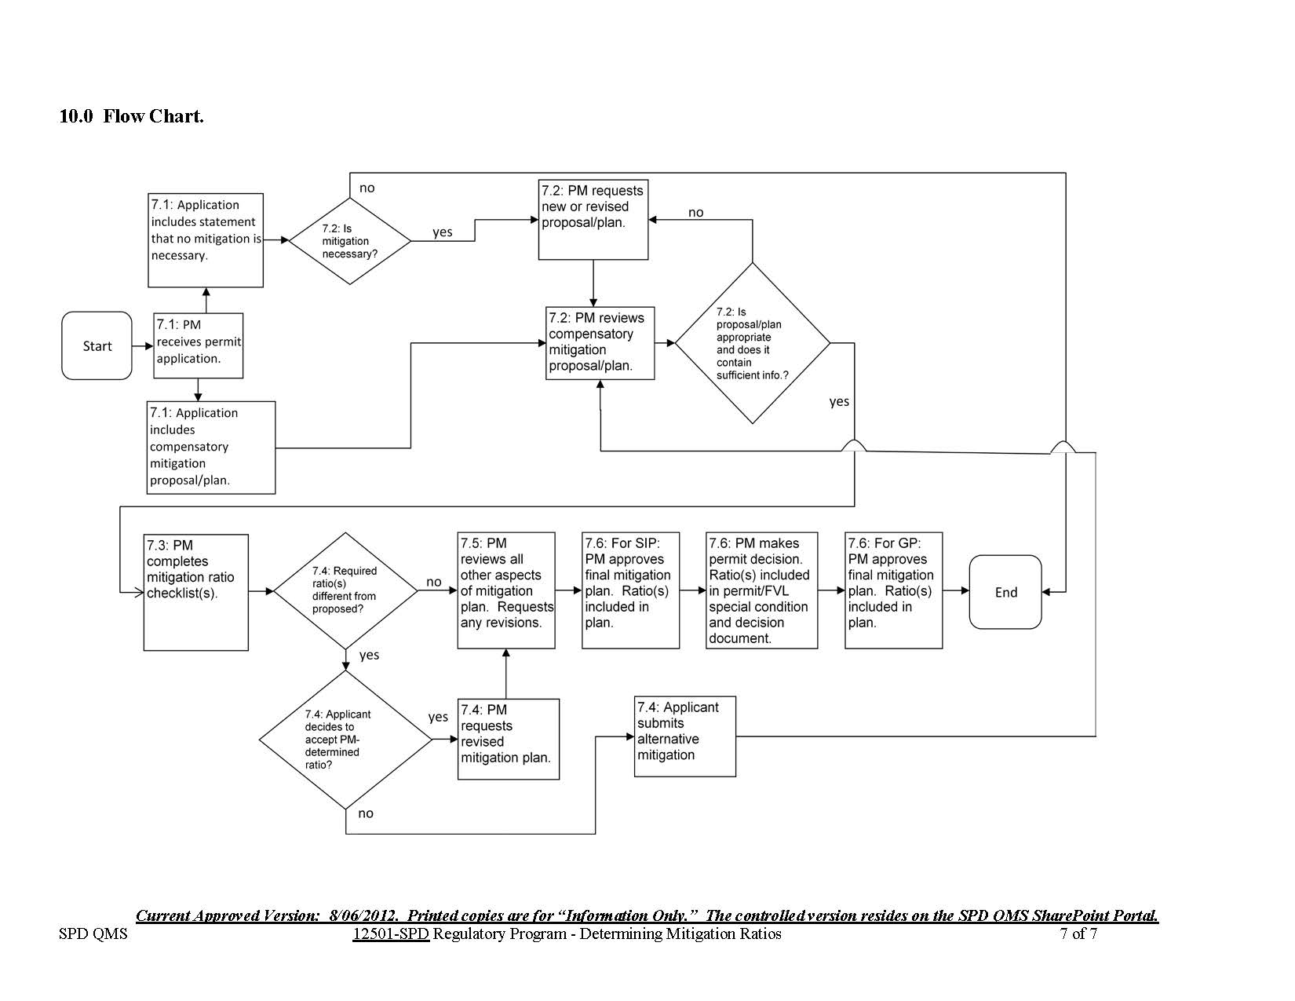
Flow Chart

Slide 6
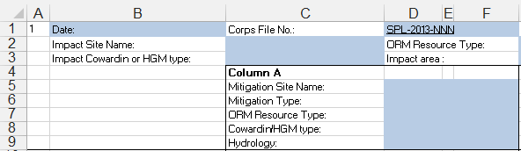
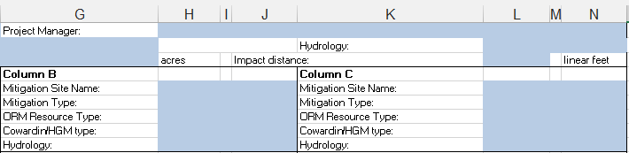
Checklist Step 1

Slide 7
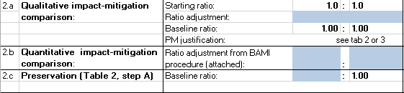
Checklist Step 2
Complete Table 1 if using step 2.a
Complete BAMI Table if using step 2.b
Complete Table 2 if using step 2.c

Slide 8
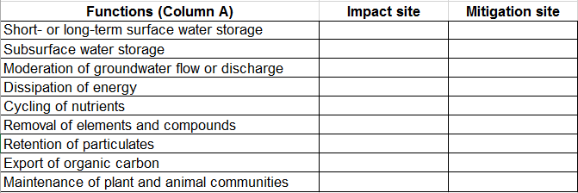
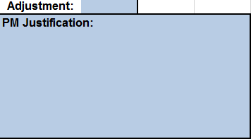
Checklist Table 1

Slide 9
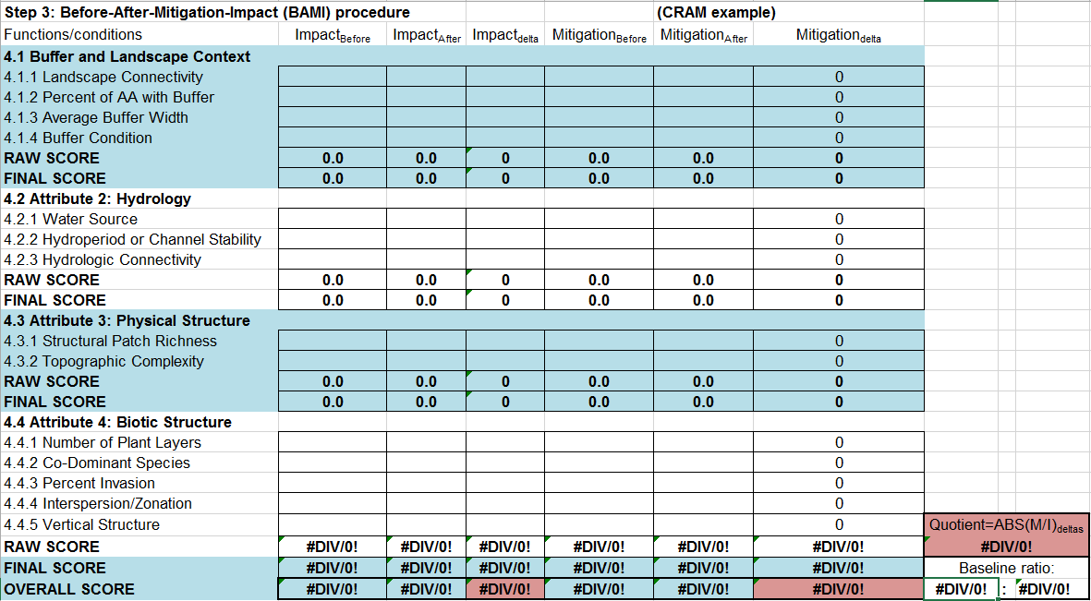
Checklist BAMI Table

Slide 10
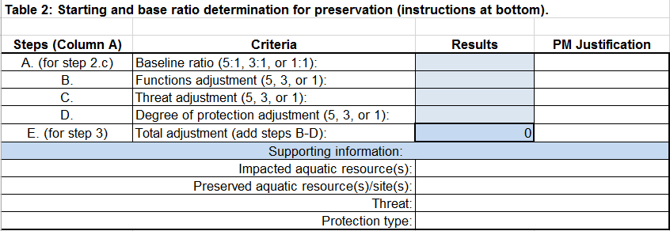
Checklist Table 2

Slide 11
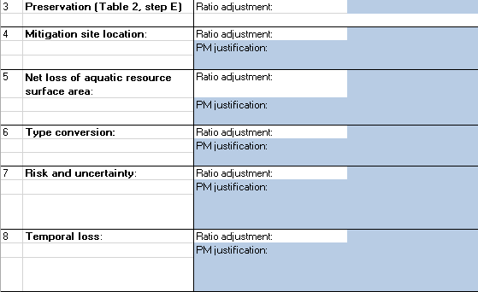
Checklist Steps 3-8

Slide 12
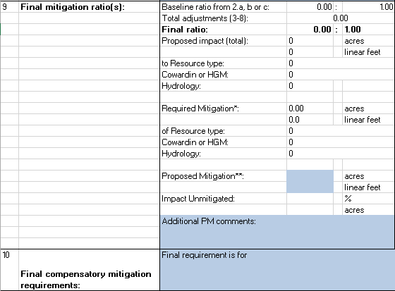
Checklist Steps 9-10

Slide 13
Checklist Tips
Use of Excel version encouraged. Benefits:
  Multiple checklists in one computer file
  Automated calculations
  Table instructions and terms included
Specific tips on following slides

Slide 14
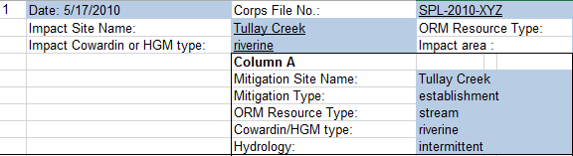
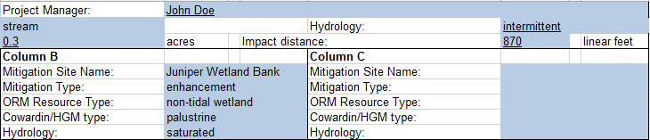
Example 1: step 1
Generally, one impact site per checklist (similar impacts can be lumped together for one checklist).
Write in mitigation type, but not the amount. Could be applicant’s proposal or project manager’s proposal.
Use either Cowardin *or* HGM classification system for impact and mitigation sites within a checklist, not both.
Complete column A first for steps 1-9, then B 1-9 (if needed), then C (if needed). Then combine results in step 10.
Alternative ways of using checklist columns:
A only (1 mitigation site/type)
A and B (2 mitigation sites/types)
A, B, and C (3 mitigation sites/types)
A vs. B (compare two proposals)

Slide 15
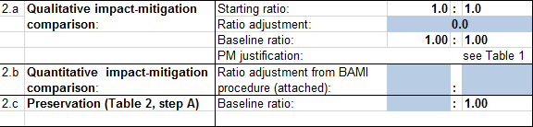
Example 1: steps 2.a-c
Step 2 adjustment added to 1:1 starting ratio to obtain “baseline ratio”
All steps in checklist are additive
Suggestion: when appropriate, request functional/condition assessment early in application process to use step 2.b!
2.a: “Starting ratio” 1:1
2.b: Not a numeric comparison. No calculations necessary.
If using step 2.b, add baseline ratio from BAMI spreadsheet
PM justification MUST be filled out for each adjustment (each step that is completed).

Slide 16
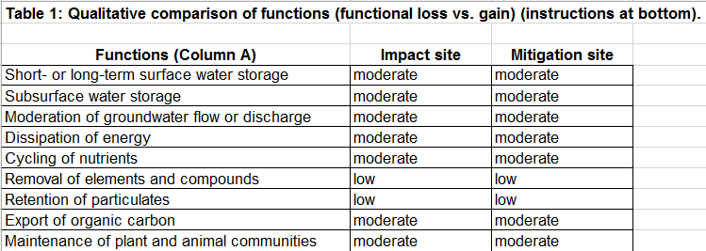
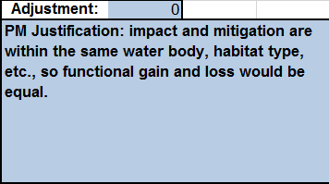
Example 1: step 2.a – Table 1
Alternative lists of functions may be used:
PM justification MUST be filled out for each adjustment (each step that is completed).

Slide 17
Step 2.a: Number Line example
Optional method for step 2.a qualitative adjustment (use in tandem with Table 1):
Draw an incremental line from -2 to 4 (range from instructions).
Will your functional gain vs. loss comparison:
  Increase the ratio (on positive side of number line: loss > gain) or
  Decrease the ratio (on negative side of number line: loss < gain))?
Tips:
  Consider the change in functions (loss and gain), not the existing or expected functions.
  Only consider functions, not rarity or value (those are considered in step 6).
Put some impact-mitigation scenarios (real or hypothetical) on the line.
Find project by bracketing among scenarios: use scenarios as reference points to help you decide where on the line to put the project in question, then decide on a numerical adjustment.
Once approximate location on line is determined, adjust up or down by tenths to account for specific impact site condition (degraded, average, high functioning).
Increasing mitigation ratio
Decreasing mitigation ratio
-2
-1
0
1
2
3
4

Slide 18
Step 2.a: Number Line example 1 (continued)
Project impacting intermittent stream (total loss), mitigating with vernal pool enhancement.
  One approach: consider several mitigation scenarios vs. proposed impact (same impact for all scenarios):
  Alternate approach: consider several impact scenarios vs. proposed mitigation (same mit. for all scenarios):
Preliminary adjustment: +2.5 to +3 (consider impact site condition to determine final adjustment)
Perennial stream re-establishment
Intermittent stream re-establishment
Intermittent stream enhancement
Vernal pool enhancement (proposed mitigation)
-2
-1
0
1
2
3
4
Intermittent stream rehabilitation / perennial stream enhancement
Ephemeral stream enhancement
gain = loss
Trapezoidal channel partial loss (bank stabilization)
Intermittent stream regular maintenance
Ephemeral stream total loss
Intermittent stream total loss (proposed)
Perennial stream total loss
-2
-1
0
1
2
3
4
Ephemeral stream regular maintenance

Slide 19
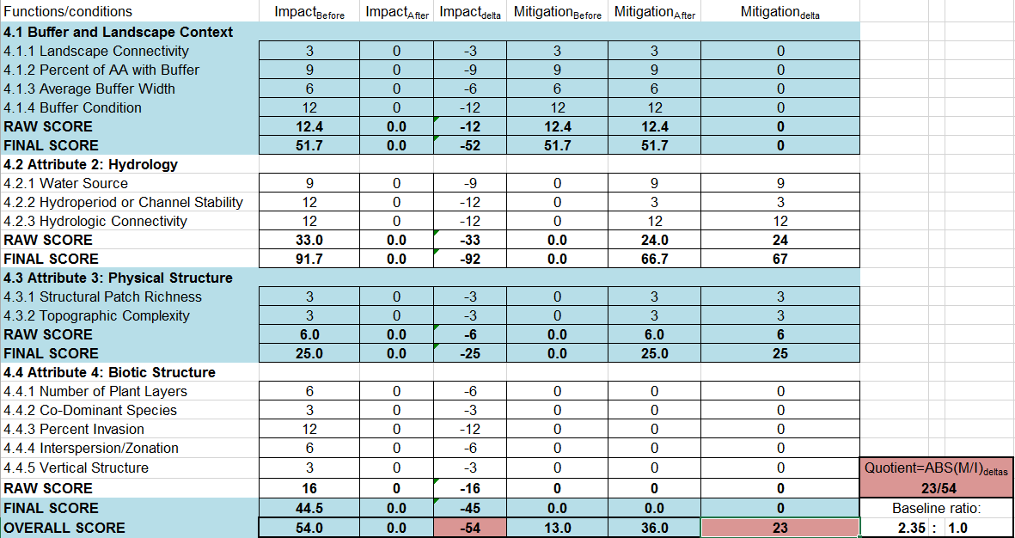
Example 6: step 2.b – BAMI using CRAM
Another appropriate method can be substituted. PM’s can adapt BAMI spreadsheet to their functional/condition assessment method and enter data provided by applicant.
In this example:
Since functional loss < functional gain, step 2.b adjusts mitigation ratio downward (less mitigation required).
Need instructions? See next slide.
Tip: Regional mitigation and monitoring guidelines recommend functional/condition assessment methods for various areas within SPD.

Slide 20
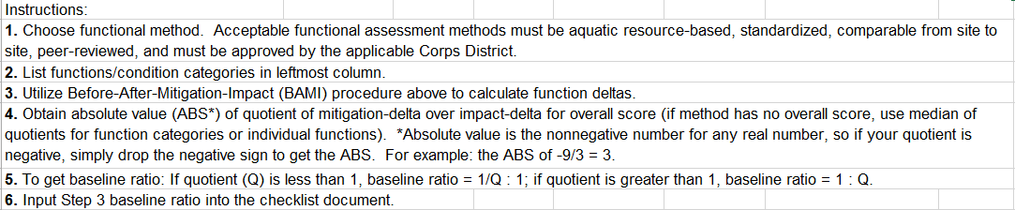
Step 2.b BAMI Instructions
Now step 2.b.
Example 1 (gain twice the loss):
Q = ABS(M/I)_{deltas} = ABS(38 ÷ -19) = 2,
Since Q is greater than 1,
Add Q to right (impact) side of ratio,
and baseline ratio = 1:Q = 1:2 = 0.5:1
Example 2 (gain a third of loss):
Q = ABS(M/I)_{deltas} = ABS(15 ÷ -45) = 0.33,
Since Q is less than 1,
Add 1/Q to left (mitigation) side of ratio,
and baseline ratio = 1/Q:1 = 1/0.33:1 = 3:1

Slide 21
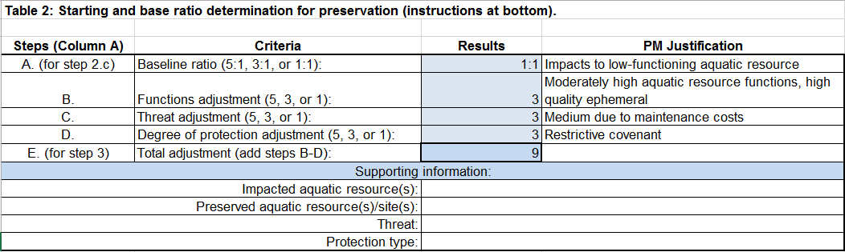
Example 9: step 2.c and 3 – Table 2
Starting ratio: enter for step 2.c.
Enter adjustments (results) here.
Total adjustment: enter for step 3.
Tip: Instructions included at bottom of Table 2.
Use if additional detail needed.
PM justification MUST be filled out for each adjustment (each step that is completed).

Slide 22
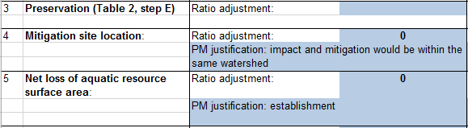
Example 1: steps 3-5
Enter Step 3 adjustment from Table 2.
Enhancement and preservation result in adjustment of +1.

Slide 23
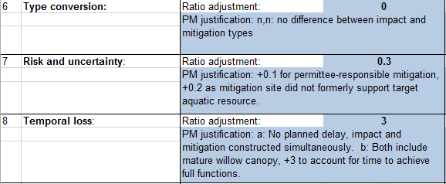
Example 1: steps 6-8
Definition of “highly valuable” will vary across ecoregions, watersheds, etc.
Note: if too many uncertainty factors are identified, this may indicate the overall mitigation proposal/design is not acceptable.
PDT chose simple approach, rather then using complex and unvalidated temporal loss equations proposed in the literature.

Slide 24
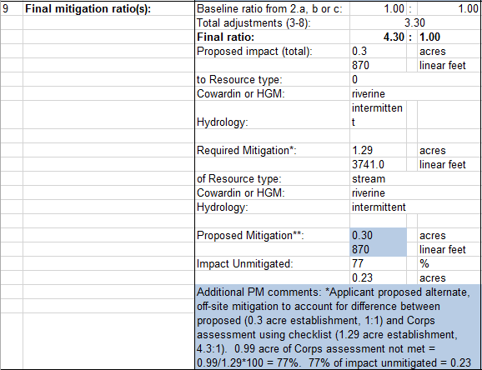
Example 1: step 9
Steps 9 and 10 should be project manager’s independent assessment of mitigation requirements. The checklist is NOT intended to match an applicant’s proposal.
Adjustments additive
Any remaining impact calculated and
carried over to next column.
Use if appropriate. Applicant’s proposal may not match Corps ratio and final requirement (they may use additional mitigation in separate columns).
Remaining impact (unmitigated impact (if any) after mitigation in column A considered.
Text narrative of final mitigation requirement for this column.

Slide 25
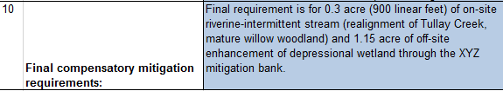
Example 1: step 10
Steps 9 and 10 should be project manager’s independent assessment of mitigation requirements. The checklist is NOT intended to match an applicant’s proposal.
Text narrative of final, combined
(all columns) mitigation requirement.

Slide 26
Frequently Asked Questions (FAQ)
Q1: Do I have to complete this checklist for all my Regulatory projects?
  A: Not for all projects. Completing the checklist is an SPD requirement for any project requiring compensatory mitigation.
Q2: What do you mean by “remaining impact” or “unmitigated impact”?
  A: This is the difference between an applicant’s initial, proposed mitigation and the mitigation requirement determined by the PM (using the checklist). If the latter is greater, the applicant may agree to the higher mitigation amount, or PM may use additional columns to evaluate additional mitigation sites/types.
Q3: Can I use any functional/condition assessment for step 2.b?
  A: Yes, if it is approved by your district and complies with district (or upcoming regional) mitigation and monitoring guidelines. Acceptable functional/condition assessment methods must be aquatic resource-based, standardized, comparable from site to site, peer-reviewed, unmodified, and approved by the applicable Corps District. Any such method should fit into the before-after-mitigation-impact (BAMI) structure and adjustment formula.

Slide 27
FAQs (continued)
Q4: should checklist be attached to decision documents?
  A: Yes.
Q5: Why are steps 2.b and 5 mutually exclusive?
  A: On the question of whether the checklist should treat consideration of a "functional/condition assessment" (step 2.b for quantitative comparison of functions/condition metrics) and "net loss of aquatic resource area" (step 5) as mutually exclusive, if a functional/condition assessment method is used that explicitly accounts for area (such as HGM), they should be mutually exclusive; however, if a method is used that does *not* explicitly account for area (such as CRAM), then both steps should be used.

Slide 28
FAQs (continued)
Q6: Why are adjustments added? Why not multiplied or averaged?
  A: These would all be equally valid methods for combining the steps of the checklist; however the PDT chose to add the adjustments and the individual adjustments are calibrated with addition in mind. Multiplying or averaging would require numerically different adjustments, although the final outcome would be the same.
Q7: For step 2.a: why is a range of -2 to 4 suggested?
  A: To account for preservation-only mitigation proposals (where functional gain would be zero), a higher penalty (mitigation ratio adjusted upwards) was deemed appropriate by the PDT (hence the upward limit of 4). The opposite case (zero functional loss) doesn’t occur for projects where compensatory mitigation is required to offset permitted impacts. For this reason, the potential downward adjustment was limited to -2.
Q8: For step 2.a: how do I qualitatively compare functions?
  A: Using a list of functions (HGM functions are provided on checklist as an example, but other lists can be used instead), the project manager should compare the proposed impact (functional loss) and proposed mitigation (functional gain) at impact (I) and mitigation (M) sites (see example 7 in attachment 12501.3). For most functions, if I < M, then use adjustment less than 0 and equal or greater than -2.0; if I = M, then use adjustment of 0; or if I > M, then use adjustment greater than 0 and less than or equal to 4. This comparison should not be a numerical calculation of change for individual functions, but rather a qualitative and relative estimate of change for each function. ***NEW***: PMs can also use the Qualitative functional comparison tool.

Slide 29
FAQs (continued)
Q9: How did the PDT come up with these specific adjustments? Aren’t these numbers subjective? How do you address that?
  A: Yes, they are subjective to some extent (this is unavoidable); however, these instructions contain specific numeric adjustments (discrete, e.g., +1.0, or ranges, e.g., +0.25 to +4.0) that were determined by the PDT after assessing a variety of impact-mitigation scenarios and determining adjustments for each step that, in combination with other step adjustments, produce a reasonable range of final mitigation ratios. For steps where a range of adjustments is provided, PMs are directed to the attached examples for additional guidance. In coming up with these numbers, we did NOT want to come up with a rigid series of equations or overly-specific requirements. Rather, we sought to provide examples and instructions with clearly-explained rationales for making various adjustments. The PM is free to deviate from these, as long as justification is provided in the checklist. The checklist requires a PM to explain in writing his/her determination for a particular mitigation ratio rather than simply cite “best professional judgment” as in the past. Will applicant’s argue over a PM’s choice of specific adjustments? Yes, but this is no different than past negotiations on mitigation requirements, and our determinations should be based on scientific information, facts, field data, etc. Also, level of analysis should be commensurate with level of impact, and arguing over small numerical differences (+0.01 vs. 0.02) would be a waste of project manager time and resources. In the end, the Corps makes its determination of mitigation requirements, and permittees can appeal if they desire.
Q10: Step 2.c and 5 seem to double count (double penalize) Preservation-only.
  A: Project managers should use their judgment. If the preservation-only mitigation proposal has been adequately accounted for in one step, the project manager can note that in the other step; however, both functional gain (or lack of) and net loss of area should be considered.

Slide 30
FAQs (continued)
Q11: How do you know functional gain if a bank is being used?
  A: From the mitigation rule, page 19685 under 332.8 for banks and ILF's: “(2) Assessment. Where practicable, an appropriate assessment method (e.g., hydrogeomorphic approach to wetlands functional assessment, index of biological integrity) or other suitable metric *must* be used to assess and describe the aquatic resource types that will be restored, established, enhanced and/or preserved by the mitigation bank or in-lieu fee project. (3) Credit production. The number of credits *must* reflect the difference between pre- and post-compensatory mitigation project site conditions, as determined by a functional or condition assessment or other suitable metric.” In summary, a bank or ILF instrument should have included some estimate of expected functional gain. If the bank never did a before assessment, a project manager can work with the bank/ILF POC (or have the sponsor prepare) an estimate of before conditions using the chosen assessment method. For most ratio determinations using the BAMI comparison, the “after” condition would be estimated prior to the mitigation ratio determination; however in this case, the “before” condition at the bank site would also be estimated. For most banks/ILF’s, there should be sufficient information of pre-existing conditions to make a “before” analysis possible. The only difference being that, for constructed banks/ILF’s, it would not be possible to verify the “before” estimate with real data as could be done for “after” estimates through post-impact and post-mitigation (monitoring) assessments.
Q12: Step 7: if a financial assurance is required and step 7 adjusts the ratio upwards for uncertainty, isn’t this double-penalizing?
  A: No, because despite having a financial assurance, the on-the-ground uncertainty does not disappear, and in order to ensure that mitigation successfully offsets impacts, additional mitigation may be required on the assumption that some portion of the site may fail, or that the overall site may never reach the expected/predicted level if functioning (in which case, the Corps may need to fund mitigation elsewhere if the permittee fails to do so).

Slide 31
FAQs (continued)
Q13: How can I base a ratio on CRAM scores using a numerical formula?
  A: using the checklist, CRAM is used quantitatively to compare functional gain and loss at the mitigation and impact sites, respectively; however, this is just one of among several steps of the checklist, each with its own adjustment. In other words, the numerical impact-mitigation comparison result does not directly, by itself, determine the mitigation ratio.
Q14: CRAM has a documented level of user error. How does this affect the ratio determination?
  A: Every functional/condition assessment method has some level of error. In addition, using a quantitative (or arguably semi-quantitative) method to compare functional gain and loss at the mitigation and impact sites, respectively, likely has less error than the undocumented error associated with “best professional judgment”-based determinations. Also, this is just one of among several steps of the checklist, each with its own adjustment.
Q15: If a multi-agency ratio-setting method has been established in my area, do I still need to use the checklist instead?
  A: Yes, the checklist should be completed, but you can continue to use the multi-agency method. You should fill out the top and bottom portions of the checklist, attach the results using the multi-agency method, and place these documents into the file as part of the administrative record.

Slide 32
FAQs (continued)
Q16: What if I get a zero (0) or negative result on the checklist?
  A: See August 2012 update slides below.
Q17: How does the mitigation preference hierarchy from the 2008 mitigation rule affect the checklist? Is the order of the mitigation types in the different columns important?
  A: The mitigation checklist is *not* designed to influence a decision regarding the preference hierarchy as stated in the mitigation rule (banks > ILF > permittee-responsible, unless deviation is warranted). That is a separate determination a project manager must make, but the checklist does not address it. Consequently, the order of mitigation types in columns A-C of the checklist isn't important. On-site mitigation, if being considered, can be in column A or B or C, depending on how the project manager wants to use the checklist.

Slide 33
FAQs (continued)
Q18: Do I need to complete the checklist for emergency projects, “self-mitigating” projects, or projects with very small impacts?
  A: Not necessarily. The project manager must determine whether compensatory mitigation is required or not. If a determination is made not to require compensatory mitigation, the checklist requirement would not be applicable.
Q19: Can I suggest changes to this procedure?
  A: Yes, this is a QMS procedure and comments can be added using the QMS system. Periodic updates/improvements are likely to occur. (But try it a few times first! ☺)

Slide 34
FAQs (continued)
*New* Q20: For new mitigation banks and ILF programs, can/should these include a procedure for setting mitigation ratios?
  From 33 CFR 332.8(r): “The district engineer will determine the number and type(s) of credits required to compensate for the authorized impacts.” Based on part (r) above, there is no requirement for bank sponsors to have any kind of crediting scheme that establishes compensatory mitigation ratios. In the past in SPD, there may have been a need for bank-specific ratio-setting procedures given there was no general procedure in place. Now for SPD, mitigation ratio determinations should be made on a project-specific basis to compare the proposed impacts with proposed mitigation using the SPD Standard Operating Procedure for Determination of Mitigation Ratios (QMS No. 12501, aka mitigation ratio checklist). Banks and ILF programs will still need a methodology for determining the numbers and types of credits to be generated (via functional assessment or otherwise) and perhaps limitations on their use. In addition, from 33 CFR 332.8(d)(6)(iv(C), ILFs should include “A methodology for determining future project-specific credits and fees.” This makes sense given any ILF will have multiple restoration projects with (potentially) different types of mitigation used at different sites warranting generation of varying amounts and types of credits. However, as for banks within SPD, mitigation ratio determinations involving ILF credits should be made on a project-specific basis to compare the proposed impacts with proposed mitigation using the SPD Standard Operating Procedure for Determination of Mitigation Ratios. Note: there is flexibility to allow for banks with special circumstances to have specific mitigation ratio specifications if the Corps, in coordination with the IRT, determines it is beneficial to the aquatic environment. However, the use of credits at the majority of banks would be governed by the mitigation checklist. Examples of banks with special circumstances could include banks for marine areas (open water, eel grass, artificial reefs etc.) which typically have lower ratios than freshwater systems, especially when other pre-existing ratio policies are in place (e.g., NMFS Southern California eelgrass policy).

Slide 35
FAQs (continued)
*New* Q21: When using ILF programs, what information do I need in order to use the checklist?
  All the same information as for permittee-responsible or mitigation banks is required in order to complete the checklist. Consequently, project managers will need to obtain more information from ILF sponsors than they may have requested in the past. For proposed use of ILF programs, the project manager should request information necessary to complete the checklist such as: the proposed habitat type(s), Cowardin or HGM type(s), location, mitigation type (establishment, rehabilitation, re-establishment, enhancement, or preservation-only), description of required long-term maintenance of any structures, description of hydrology, and the probable timing of the mitigation (and any other sources of uncertainty). For ILF programs with a "standing proposal" ready to implement or an on-going project with available credit, temporal loss may be zero or minimal. If the ILF would need to develop a new project “from scratch,” temporal loss may be substantial enough to be accounted for in the checklist depending on the anticipated delay between implementation of impacts and mitigation.
*New* Q22: How is landscape connectivity within watershed incorporated into ratio-setting procedure?
  Currently landscape connectivity (extent to which aquatic resource at mitigation site connects to surrounding aquatic resources or associated upland habitats across landscape over relatively large extents) should be part of the impact-mitigation comparison (step 2 or 3). When using step 2 (qualitative comparison), functions related to the maintenance of plant and animal communities can include consideration of landscape connectivity. For step 3 (quantitative comparison), some functional/condition assessment methods, such as CRAM, explicitly account for landscape connectivity.

Slide 36
FAQs (continued)
*New* Q23: What are the highest ratios possible using the mitigation ratio-setting checklist procedure when preservation-only is proposed?
  See slides regarding 2016 Preservation-Only Update

Slide 37
January 2012 update
Revisions to QMS document (12501):
At SPD’s direction, added to section 2: "Subordinate offices or organizations shall not modify this procedure to form a specific procedure.”
QMS section 2.0: added date for applicability (all permit applications received after April 20, 2011).
Added statement that PM justification is required, not optional.
QMS step 7.6: changed “Note: The process outlined herein can also be used for determining compensatory mitigation requirements for unauthorized activities.” To “Note: The process outlined herein can also be used for determining compensatory mitigation requirements for unauthorized activities for which the Corps is the lead enforcement agency.”
Added training presentation to attachments

Slide 38
January 2012 update (continued)
Revisions to attachment 12501.1 (checklist):
Change to steps 2 and 3 (now steps 2.a and 2.b): dropped threshold-based criteria for whether to use step 2 (qualitative impact-mitigation comparison) or step 3 (quantitative comparison using a functional or condition assessment) and replace with: “Has a Corps-approved functional/condition assessment been obtained?” If not, step 2 is used; otherwise, step 3 is used. Thresholds (0.5 acre, 300 linear feet) moved to in instructions as recommendations for when a functional/condition assessment should be required.
Based on coordination with Office of Counsel and HQ: on the question of whether the checklist should treat consideration of a "functional/condition assessment" (step 3 for quantitative comparison of functions/condition metrics) and "net loss of aquatic resource area" (step 5) as mutually exclusive, if a functional/condition assessment method is used that explicitly accounts for area (such as HGM), they should be mutually exclusive; however, if a method is used that does *not* explicitly account for area (such as CRAM), then both steps should be used. [change also made in instructions and examples]

Slide 39
January 2012 update (continued)
Revisions to attachment 12501.2 (instructions) and 12501.3 (examples):
Instructions: Added statement that PM justification is required, not optional.
Instructions: Added note to step 2: “adjustments for preservation-only mitigation, which provides no functional gain, should generally fall towards the high end of the range (towards 3-4). Preservation-only of non-aquatic habitats (upland buffer) may warrant adjustments higher than 4.”
Instructions: Last page: Compute log of quotient multiplied by 2.5 to obtain adjustment for step 4. [change “4” to “3”]. Input Step 4 adjustment into the checklist document. [change “4” to “3”]
Example 3 – column B > re-examine functional loss vs. gain > loss is probably higher than gain. Changed mitigation type in column B to “establishment”, matching type on introduction page.
Example 5: Step 2 states rehabilitation does not provide functional gain—this is not correct: From the mitigation rule, “Rehabilitation” means the manipulation of the physical, chemical, or biological characteristics of a site with the goal of repairing natural/historic functions to a degraded aquatic resource. Rehabilitation results in a gain in aquatic resource function, but does not result in a gain in aquatic resource area. Example revised accordingly.

Slide 40
August 2012 update
Revisions to checklist and instructions:
Modified checklist procedure to use a variable “baseline ratio” determined by step 2 or 3 (now steps 2.a and 2.b). For either step, the “starting ratio” is 1:1 (rather than 0:1) and is modified by step 2 or 3’s adjustment to determine the baseline ratio.
  Previously, the adjustments were added starting from 0 (starting ratio of 0:1).
  PDT determined 1:1 is the correct starting point from which to make ratio adjustments.
  Rationale: one cannot have more functional loss at the impact site than functional gain at the mitigation site and end up with less than a 1:1 ratio (except perhaps if going from a common habitat type to a rare one).
  To illustrate the point, in the simplest case of steps 4-8 of the checklist being 0 (assuming no uncertainty, no temporal loss, etc. which is realistic if a mitigation bank is proposed), and the project manager uses step 3 of the checklist (Before-After Mitigation-Impact functional comparison) on a situation where functional loss at the impact site equals functional gain at the mitigation site. If the project manager adds 0 to a “starting ratio” of 0:1 (per the previous checklist procedure), the result would be a 0:1 final ratio (no mitigation required) which does not make sense. However, if instead the project manager adds 0 to a “baseline ratio” of 1:1, the final result would be 1:1 which conceptually agrees with the equal values for functional loss and gain.

Slide 41
August 2012 update (continued)
Revisions to checklist and instructions:
Modified step 2.a (qualitative comparison of functional gain and loss):
  Would incorporate a “starting ratio” of 1:1 which would then be modified based on an adjustment range of -2 to +4 (modified from previous range of -2 to +5 to matching the PDT’s original intended range based on previous scenarios and examples).
Modified step 3 (BAMI procedure for quantitative comparison of functional gain and loss):
  Logarithmic conversion replaced with a simplified procedure using the quotient of mitigation-delta over impact-delta. Depending on result, quotient is added to the left (mitigation) OR right (impact) side of the starting ratio (1:1) to set the baseline ratio.
  Added a statement to the instructions cautioning PMs against considering extreme mitigation proposals: In an extreme case, the BAMI procedure could result in a ratio (and overall mitigation proposal) unacceptable to the Corps. For example, providing a very large but low quality mitigation site (low functional gain resulting a in a very high ratio) may result in functional gain equaling loss numerically, but this may not be acceptable given consideration of mitigation goals and watershed needs.

Slide 42
August 2012 update (continued)
Revisions to checklist and instructions:
Modified checklist to incorporate “negative” results:
  For step 6 (type conversion), it is possible to obtain a negative adjustment (for example, if a low value aquatic resource is proposed to be replaced by a high value and/or rare aquatic resource).
  For step 9, if total of adjustments is greater than 0 (positive), add total to left (mitigation) side of baseline ratio; however, if total of adjustments is less than 0 (negative), add ABS of total to right (impact) side of baseline ratio.
  Rationale for change: if a functional or condition assessment is used for step 3 (currently infrequent), and is coupled with proposed mitigation at a bank (especially with bank credit for re-establishment or establishment), a negative checklist result is a likely outcome. Likely cases would be where no/little loss of waters would occur, and functions would be decreased slightly by the addition of minimal structures, etc. Given the increasing likelihood of obtaining a negative ratio result from the checklist as the use of functional/condition assessments increase, the PDT spent some time discussing how to incorporate a negative result. Assuming a given project would incur impacts requiring compensatory mitigation, a negative result where functional gain is greater than the loss should logically “translate” into a ratio somewhere between 0 and 1 (not negative). This reflects credit for the higher functional gain but still requires some compensation. To implement this logical framework, the checklist was modified so that a total negative adjustment (when all adjustments are added at the end of the checklist) would be added to the right side of the mitigation-impact ratio (M:I). Under these proposed, modified instructions, if all step adjustments total 0, the project manager would obtain a 1:1 final ratio. If all step adjustments produce a positive adjustment total (the typical scenario), the project manager would add this total to the "left side" of the ratio (i.e., the mitigation side). For example, if step adjustments total 0.6, the final ratio would be 1.6:1. Conversely, if all the step adjustments produce a negative adjustment total (rare, requires use of step 3 with a quantitative functional/condition assessment), the project manager would add the value of this total to the "right side" of the ratio. For example, if step adjustments total -0.6, the final ratio would be 1:1.6 (alternatively expressed as 0.625:1). In this latter case, the negative sign would result in a mitigation requirement below 1:1 but still greater than 0. Using these modified instructions, all positive adjustments would result in ratios greater than 1:1 and all negative adjustments would result in ratios less than 1:1.

Slide 43
August 2012 update (continued)
Revisions to checklist and instructions:
Updated original five examples and added three new examples, two of which incorporate the step 3 BAMI procedure.
Added two new FAQ’s to training presentation (No.’s 20 and 21) related to use of the checklist with mitigation banks and ILF programs.
Added checklist in Excel format (attachment 6)

Slide 44
November 2012 update
Revisions to checklist and instructions:
Corrected final score equations in the BAMI spreadsheet (attachments 4 and 6);
Clarified language in instructions for step 2.a to indicate only a single adjustment should be used for all functions combined (i.e., each function doesn't have a separate adjustment) (attachments 2 and 6);
In response to suggestions, added table for step 2.a to checklist in attachments 1 and 6 (as shown in example 7).

Slide 45
July 2013 update
QMS Document 12501: added clarification to section 2 (Applicability):
For NWPs re-verification requests where the mitigation ratio checklist was not completed previously, use of the checklist is required in order to ensure minimal impacts (including consideration of compensatory mitigation), to ensure compliance with the 2008 Mitigation Rule (33 CFR Part 332), and to comply with this new QMS procedure designed to ensure compensatory mitigation is sufficient to offset authorized impacts. For individual permits (SIP and LOP), if the original application predates this QMS procedure (effective 20 April 2011), the checklist would not be required for subsequent modification requests (time extension or activity modifications), unless the requested modification includes a substantial increase in impacts. In addition, in cases where compensatory mitigation has already been constructed or where the applicant can otherwise fully demonstrate substantial resources have been expended or committed in reliance on previous guidance governing compensatory mitigation for DA permits, the checklist would not be required.

Slide 46
July 2013 update (continued)
QMS Document 12501: added caveat to section 7 (Procedures):
Some states within SPD’s AOR contain over appropriated basins, which make it very difficult to obtain an adequate water right to secure site hydrology. In some SPD states the authority responsible for managing water rights may impose a 1:1 area-based limit on compensatory mitigation projects. In these situations the PM is still required to determine a compensation ratio using the mitigation checklist. If adequate water rights are not available to support an establishment or re-establishment ratio greater than a 1:1, the PM will consider options such as non-consumptive enhancement/rehabilitation projects, preservation, buffer establishment/restoration and protection, and restoration of floodplain connectivity, to obtain appropriate and practicable compensatory mitigation.

Slide 47
July 2013 update (continued)
Revisions to attachments:
12501.1 (checklist in Word format) and 12501.6 (checklist in Excel format): added fields for impact and mitigation site hydrology;
12501.2 (instructions): added fields for impact and mitigation site hydrology, added clarification for step 9 (expressing ratios);
12501.3 (examples): various corrections;
12501.5 (training presentation): updated;
12501.6 step 9 (checklist in Excel format): minor correction to Excel formulas.

Slide 48
September 2016 Update Summary
Why is a modification needed?
National Survey PO Results (2011)
PO Modification Details
Mitigation Rule criteria for preservation
New PO Methodology
Expected Results
Questions/Issues Addressed

Slide 49
Why is a Modification Needed?
Two minor errors in the mitigation ratio checklist documents needed to be corrected.
  See 12501 Revisions sheet.
Third, more substantial issue: checklist needed to be modified in how it accounts for preservation-only (PO) mitigation.
  With prior checklist, using the quantitative BAMI procedure (step 3) could result in a higher ratio for enhancement than for PO (using qualitative step 2).
  Ratios for PO were not clear (the prior checklist instructions and examples provided little guidance, especially when buffer was considered).
  Prior checklist steps 2 and 3 assessed functional gain vs. loss, but PO mitigation does not result in gain.
  Prior PO ratios were lower than those used by districts nationwide (2011 survey).

Slide 50
National Survey PO Results (2011)
MVR: Buffer – 4:1 (4 acres of buffer = 1 bank credit)
Wilmington: wetland: 5:1, stream: 2.5-5:1
NWS: 5-10:1 if in combination with other mitigation methods
MVP: 8:1
Omaha: 10:1
Charleston: 10-15:1
Norfolk: wetland: 10:1, upland buffer preservation: 20-40:1
SPD (using prior checklist): 6:1 maximum* for PO of WoUS, higher if PO partially or completely uplands
* +5 from step 2, +1 for net loss (not including other adjustments which vary)

Slide 51
Preservation-Only Modification
New range for PO (baseline ratio): 5-20+
Justification:
  The mitigation ratios average is approximately 10:1 (20:1 was used for Norfolk as the maximum of 40:1 was deemed an outlier).
  As a result, most compensatory mitigation ratios for preservation associated with aquatic resources with moderate functions and services are expected to be distributed around 10:1, but could range from 5-20+:1 when compensating for aquatic areas with relatively low functions (5:1) and for areas with relatively high functions (20+:1).
New methodology: added new steps (2.c and 3) using mitigation rule criteria for preservation at 33 CFR Part 332.3(h)(1) to determine ratio adjustment for PO mitigation.

Slide 52
Mitigation Rule preservation criteria
Combine (similar):
  (i) The resources to be preserved provide important physical, chemical, or biological functions for the watershed;
  (ii) The resources to be preserved contribute significantly to the ecological sustainability of the watershed. In determining the contribution of those resources to the ecological sustainability of the watershed, the district engineer must use appropriate quantitative assessment tools, where available;
(iii) Preservation is determined by the district engineer to be appropriate and practicable: N/A (not quantifiable)

Slide 53
Mitigation Rule preservation criteria (continued)
(iv) The resources are under threat of destruction or adverse modifications; and extent of threat:
(v) The preserved site will be permanently protected through an appropriate real estate or other legal instrument (e.g., easement, title transfer to state resource agency or land trust).
Assumption: PO sites must meet MR criteria, but there is a range of how well criteria are met (i.e.: would PO site provide somewhat important functions (low end of range), moderately important functions, or very important functions? )

Slide 54
New PO Methodology
Starting ratio for PO will be 1:1, 3:1, or 5:1 (this is important to ensure PO ratios end up being high enough to match the target range):
    Depends on expected functional loss at impact site (1:1 low; 3:1 Moderate; 5:1 high)
Criteria i and ii (functions): Describe existing functions by requiring FCAM where available (otherwise make qualitative determination using table)(note: these are all within a range of high functional scores):
    Low end of range (>75% of reference standard FCAM score) (+5)
    Medium part of range (>85%) (+3)
    High end of range (>95%) (+1)
    *Assumption: waters of the U.S. and riparian buffer can fall into any category, but upland buffer (which by definition can’t have an FCAM score) should always assumed to be in low part of the range.

Slide 55
New PO Methodology (continued)
Criteria (iv): level of threat:
    Low (+5) (increasing/continuing trend of development in watershed)
    Medium (+3) (site shown as developed in specific/general plan)
    High (+1) (development entitlements/permits in place)
Criteria (v): “degrees” of long-term protection:
  Low (management plan) (+5)
  Medium (restrictive covenant/deed restriction) (+3)
  High (conservation easement) (+1)

Slide 56
Expected Results
Checklist scenarios produced range in final ratio of +6 to +18
Average final ratio: +12 for PO mitigation (for scenarios)
+26 in worst case: maximum PO criteria adjustments, PO of upland stream buffer, impact to vernal pool, mitigation outside impact watershed. Note: this scenario is unlikely.

Slide 57
Questions/Issues Addressed
Why +1, 3 or 5?
  Tried criteria adjustments of 0, 2.5, 5 and 1, 3, 5 and 2, 4, 6.
  0, 2.5, 5 gave results for PO (2:1 for vernal pool preservation) less than ratios using current checklist.
  1, 3, 5 fit target range.
  2, 4, 6 resulted in ratios that were too high.
Why not just extend the range for step 2?
  Step 2 (and 3) assess functional gain and loss, PO mitigation does not result in a gain. Therefore, it is confusing for PMs to try to apply PO to this step.

Slide 58
Questions/Issues Addressed (continued)
Does this address only PRM?
  No, it would also apply to PO credits provided by a bank/ILF.
Why do we need this?
  The Mitigation Rule explicitly allows for preservation only (although it encourages preservation in conjunction with other types).
  Preservation of buffers is allowable under Mitigation Rule.
  Preservation is commonly part of mitigation plans for aquatic resources or buffers abutting/adjacent to sites undergoing more active mitigation (enhancement,
  restoration, etc.)
  This doesn’t affect the decision on whether PO is acceptable for a given project

Slide 59
POC’s (PDT)
SPL: Dan Swenson (PDT lead)
SPD: Thomas Cavanaugh
SPK: Will Ness
SPN: Bryan Matsumoto
SPA: Deanna Cummings

Slide 60
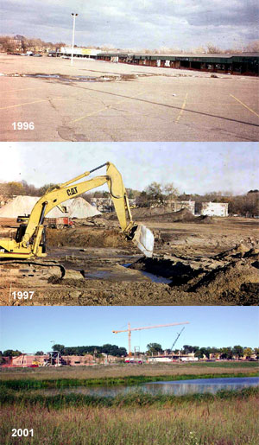
Questions?

