Slide 1
South Pacific Division
Uniform Performance Standards for
Compensatory Mitigation Requirements
August 2012
(12505.4-SPD – An attachment to
12505-SPD – Current to 8/09/2012)
Notes:
On behalf of the South Pacific Division, I welcome you to (event name)
16 Photos (3-4 each district; 3 SPD): clockwise starting at top right:
Bald eagle art of Lake Sonoma by Robert Garcia (Vietnam Vet; Army River Pirate), Corps employee in SPN.
Earl Flint (90 yrs old in 2010) fishing at Conchas Dam which he helped build during the depression (Gallery) 14 May 2010, Conchas Dam and Albuquerque District celebrated their 75th anniversary.
SPN - Raccoon crewman during debris removal in SF Bay
SPL - Border fence construction
SPK - Park ranger bald eagle banding
SPK - Folsom bridge
SPA - Bosque restoration
SPD - Kelley Aasen, Mark Wingate-EM Ops
SPA - MILCON Air force Hanger
SPL - MILCON Ft. Irwin & Army MILCON
SPK & SPN - Bay Bridge earthquake retrofit consultation (Gallery)
SPA - LEED certification of BIA schools
SPN - Construction
SPN - Fari Tabatabai in Afghanistan
SPL - Construction Ft. Irwin
SPL - Prado Dam
SET THE STAGE:
Strategic Landscape
Reinforce our Conference Theme
Provide a Common Regional Picture (CRP)
Define Expectations
Understand our Purpose / Agenda
JOHN C. MAXWELL
Grow Personally/Professionally.
Set the Course for Significant Growth to Your Potential. “We cannot achieve our wildest dreams by remaining who we are.” The Journey From Success to Significance
Setting the Course for Significant Growth: ATTITUDE (knowing how to feel); PRIORITIES (knowing how to choose); VISION (knowing how to see); DIRECTION (knowing how to begin); CREATIVITY (knowing how to think); and RESPONSIBILITY (knowing how to finish).

Slide 2
Summary
General details
List of documents
Procedure: flow chart
Table of Uniform Performance Standards
Worksheet
Examples
FAQ’s
POC’s

Slide 3
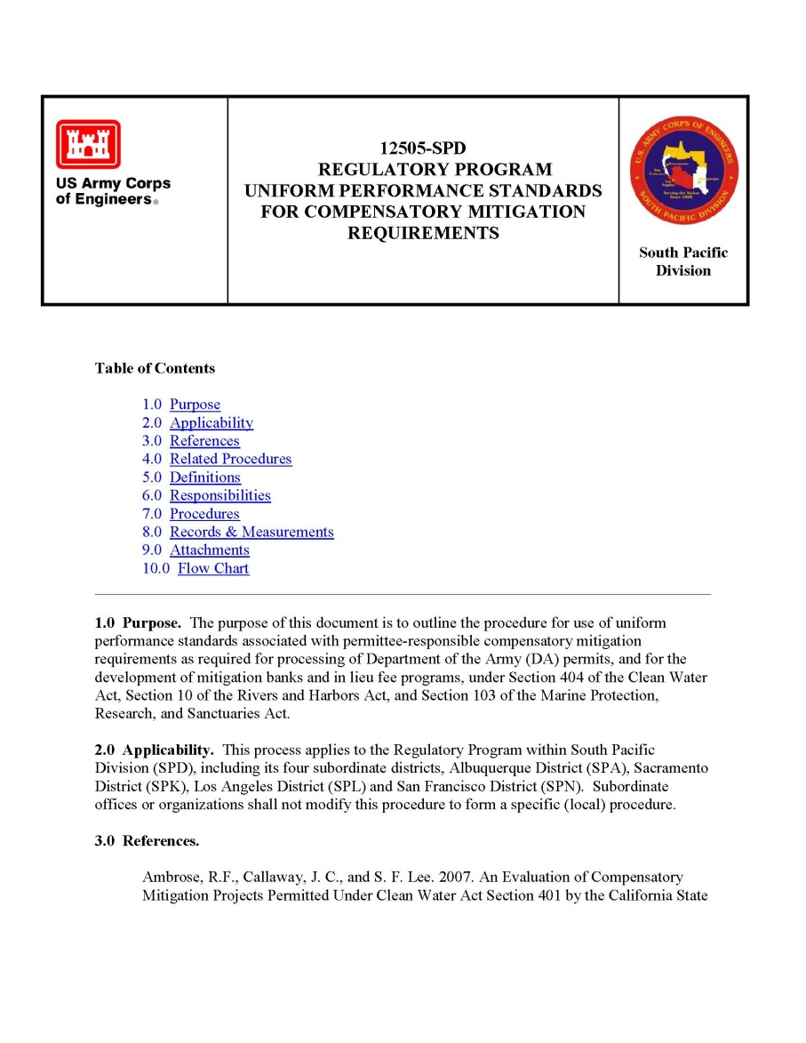
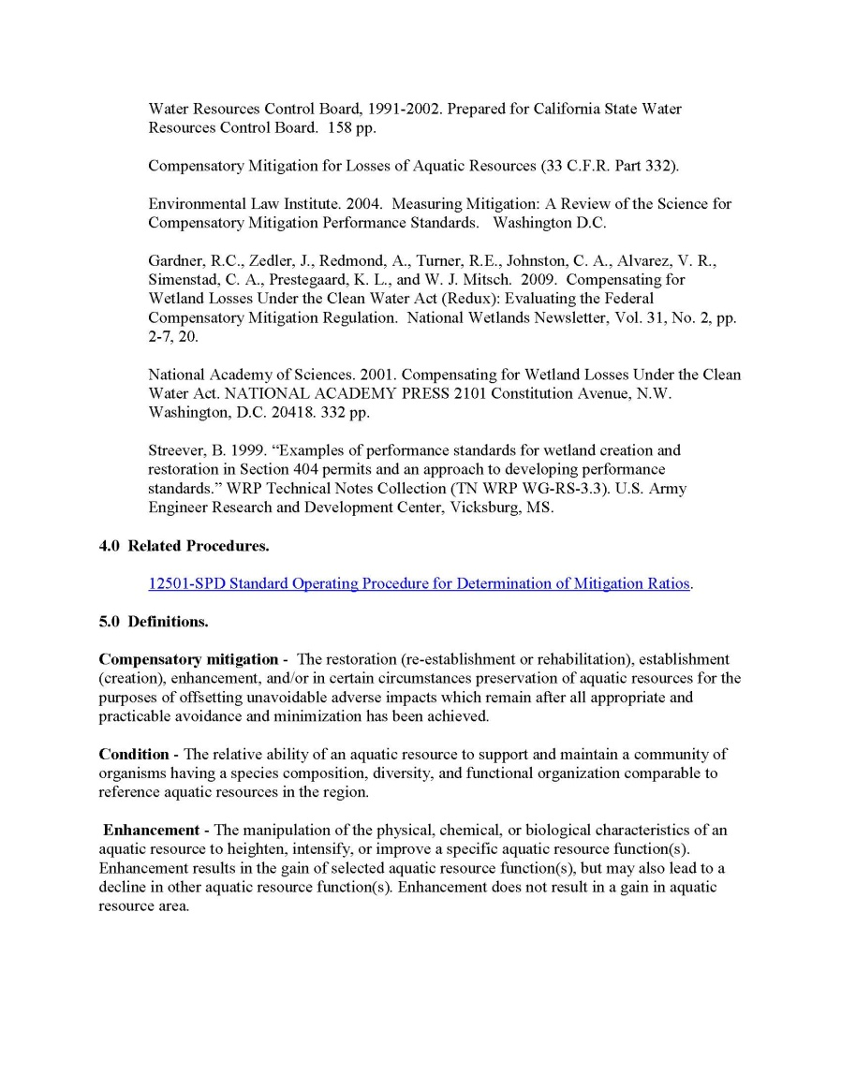
Uniform Performance Standards for Compensatory Mitigation Requirements

Slide 4
Uniform Performance Standards
Finalized May 2012, by regional PDT (3 year effort)
Updated August 2012
Benefits:
Better predictability for regulated community
Increased ability of Regulatory agencies to ensure compliance
Better gauge of long-term ecological viability of mitigation sites
Allow improved scientific comparison between mitigation sites
Focus:
Ecological performance standards (not water treatment)
Incorporation of reference sites
Incorporation of functional/condition assessments
Applicability:
Permittee-responsible mitigation
Development of mitigation banks and in lieu fee programs

Slide 5
Uniform Performance Standards
Overall goals:
Uniform PS language, not specific targets
Why? Specific targets would require substantial research
Different aquatic resources and ecoregions throughout four Districts
Good goal for future, funded effort by region
Expand beyond flora-based PS
Why? Flora-based PS do not represent full suite of ecological functions provided by impacted and mitigation sites
Preliminary tie-ins in to existing functional/condition assessments
Area for future expansion as use of functional/condition assessments increases

Slide 6
Uniform Performance Standards
Procedure includes:
1 Flowchart
2 Attachments
1. Table of Uniform Performance Standards (Excel file)
2 . Worksheet
3. Examples
4. Training presentation

Slide 7
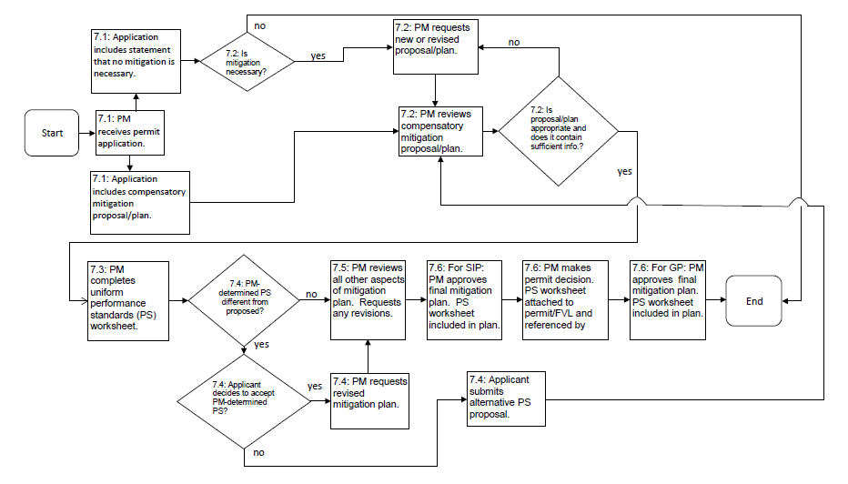
UPS Flow Chart

Slide 8
Attachment 1 Table of Uniform Performance Standards
Excel spreadsheet format
Types of aquatic resources addressed:
Riverine
Tidal
Slope wetlands
Depressional wetlands
(Buffer habitat)
Types of performance standards included:
Physical
Hydrologic
Faunal-Diversity Index
Flora
Water quality (ecological)

Slide 9
Attachment 1 (continued) Table of Uniform Performance Standards
Table fields (columns):
Performance Standard
Reference
Target
Timing
Applicability
Suggested measure
CFCAM metric
Design considerations
Guidance
Table “demo” in Excel
Open attachment 12505.1

Slide 10
Attachment 2: UPS Worksheet

Slide 11
Attachment 2: UPS Worksheet

Slide 12
Attachment 3: Examples
Establishment of southern willow scrub riparian habitat
Re-establishment of depressional wetlands and associated swales
Restoration of historic salt marsh habitat

Slide 13
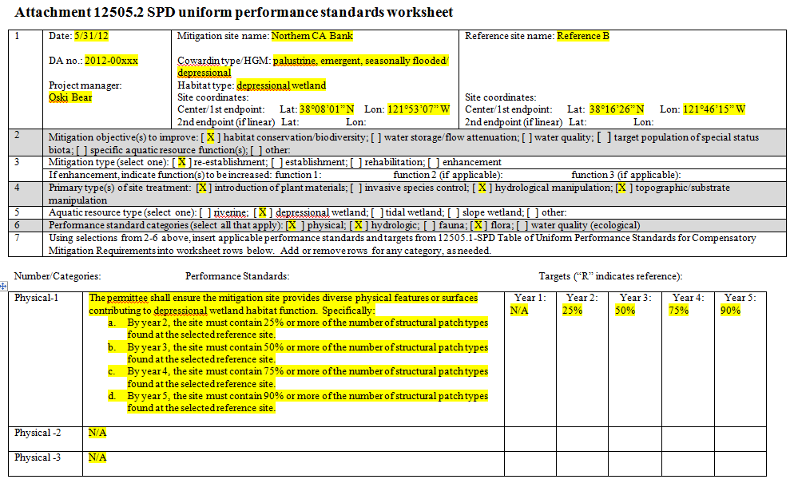
Example 2: Re-establishment of depressional wetlands and associated swales (page 1)

Slide 14
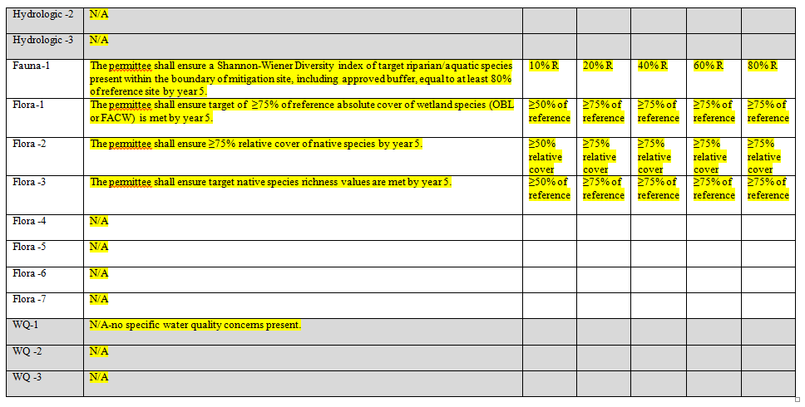
Example 2: Re-establishment of depressional wetlands and associated swales (page 2)

Slide 15
Frequently Asked Questions (FAQ)
Q1: Do I have to complete the UPS worksheet for all my Regulatory projects?
A: Completing the UPS worksheet is an SPD requirement for any project requiring compensatory mitigation (Permittee-responsible), as well as for the development of mitigation banks and in lieu fee programs.
Q2: If multi-agency performance standards have been established in my area for a particular habitat type, do I still need to use this procedure instead?
A: Yes, the UPS worksheet should be completed and stored as part of the administrative record, but you can continue to use the multi-agency performance standards.
Q3: How should the UPS worksheet be included in the administrative record?
A: The final worksheet must be included in the final mitigation plan, and/or as an attachment to and by special condition in the permit/final verification letter (the preference is for the worksheet to be included in both).

Slide 16
FAQs (continued)
Q4: The table includes a large number of performance standards. Am I required to use all of them?
A: Use as appropriate. As stated in part 7.3.6: “The PM will select all applicable performance standard categories (hydrologic, physical, fauna, flora, water quality (ecological). While some performance standard categories may not be applicable to all aquatic resource types and/or mitigation types, in general, project managers should strongly consider selecting all categories (except for water quality which should be selected when specific water quality concerns are present), with the exception of cases where the mitigation type is to be enhancement, as enhancement by definition only increases one or a few functions. For re-establishment, establishment, and rehabilitation, selection of all performance standard categories will ensure that functional lift is measured across the full range of functions.”
Q5: The uniform performance standards don’t apply to my watershed/habitat type/ecoregion- what should I do?
A: If more applicable, scientifically-based performance standards and/or targets are available for habitats in your area, these can be used. However, from part 7.3.7 of the procedure: “The PM may deviate from the performance standards and targets contained in the SPD Uniform Performance Standards Table (attachment 12505.1); however, alternative performance standards must be both measurable and enforceable. If in doubt, a project manager should consult his/her supervisor, a senior project manager, or any member of the uniform performance standards PDT.”

Slide 17
FAQs (continued)
Q6: Many of the categories (such as riverine physical) have multiple performance standards- how do I choose?
A: As a first step, review the columns in grey. These are the “guidance” columns (applicability, suggested measure, CFCAM metric, design considerations, guidance) and should help you decide if a particular performance standard applies to your proposed mitigation site. If you’re still in doubt, seek the advice of your supervisor, a senior project manager, and/or one of the members of this PDT (POC’s listed below).
Q7: Can I suggest changes to this procedure?
A: Yes, this is a QMS procedure and comments can be added using the QMS system (or sent directly to the PDT). Periodic updates/improvements are likely to occur. (But try it a few times first! ☺)

Slide 18
POC’s (PDT)
SPA: Deanna Cummings
SPD: Thomas Cavanaugh
SPK: Will Ness
SPL:
Dan Swenson (PDT lead)
Corice Farrar
Spencer Macneil
Michelle Mattson
Sallie McGuire
Stephen Estes
John Markham
Jae Chung (now at IWR)
SPN:
Laurie Monarres
David Wickens
Sahrye Cohen
Paula Gill
Philip Shannin (now at SAS)

Slide 19
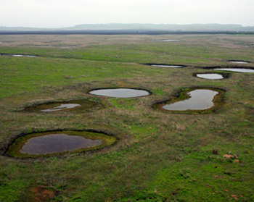
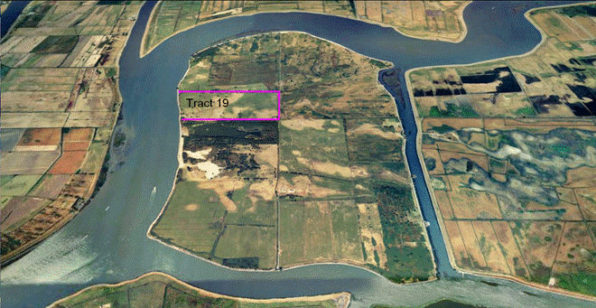
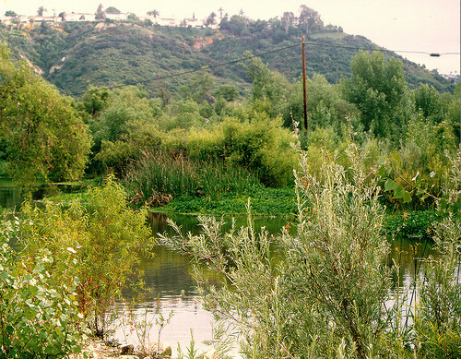
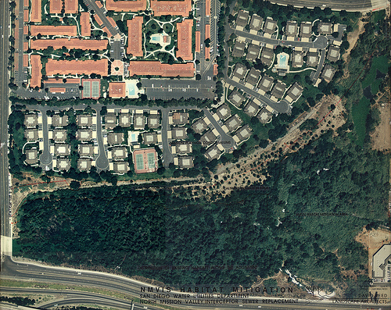
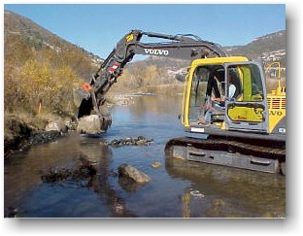
Questions?

